Slide 1
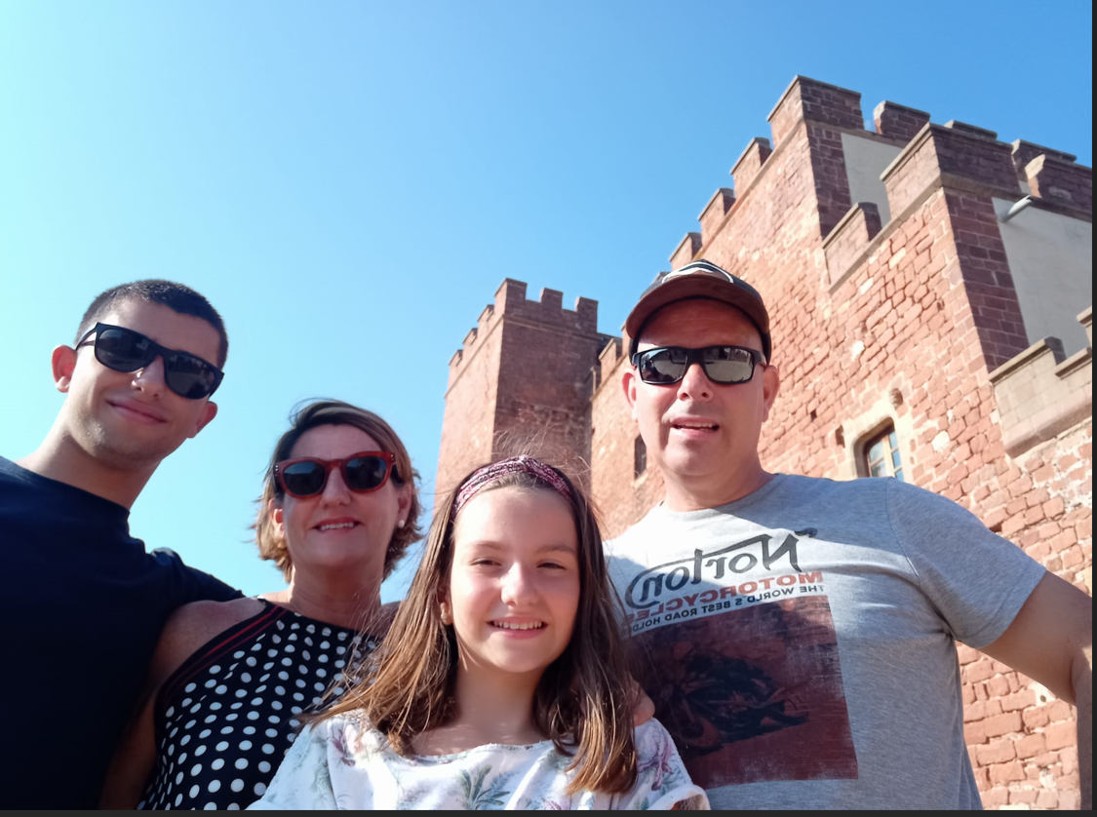
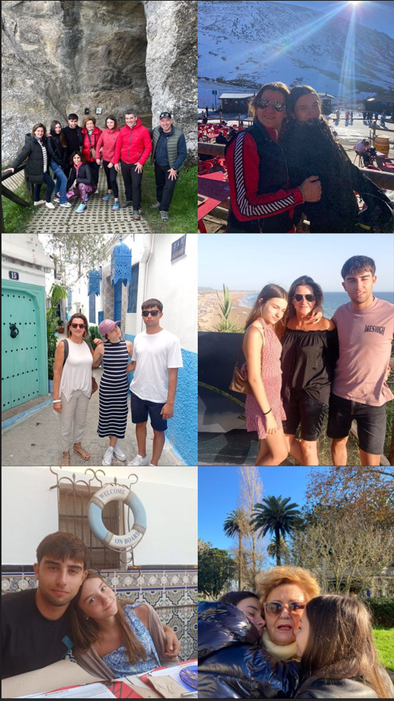
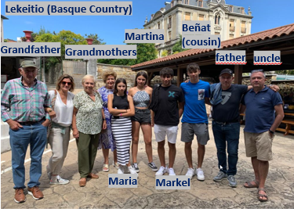
Family weekend
Hi I´m Maria and I would like to introduce my family
Markel (brother)
Asier (father)
Christmas ski weekend in Astún
Izortze (mother)
Maria
Tanger
Conil (Cádiz)
This is a family picture in Lekeitio (Basque coast),
the place where we spent the month of August
July 2023 in Cádiz (South os Spain) and a day trip to Tangier
My brother and me
Maria and Martina (cousin ) with grandma

Slide 2
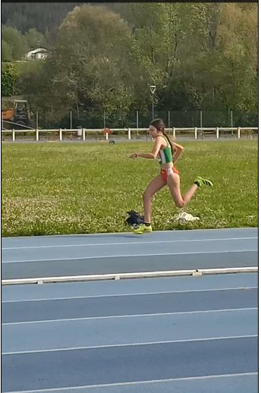
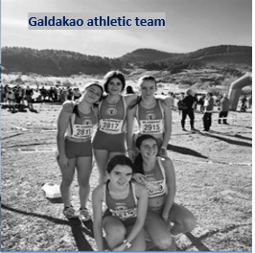
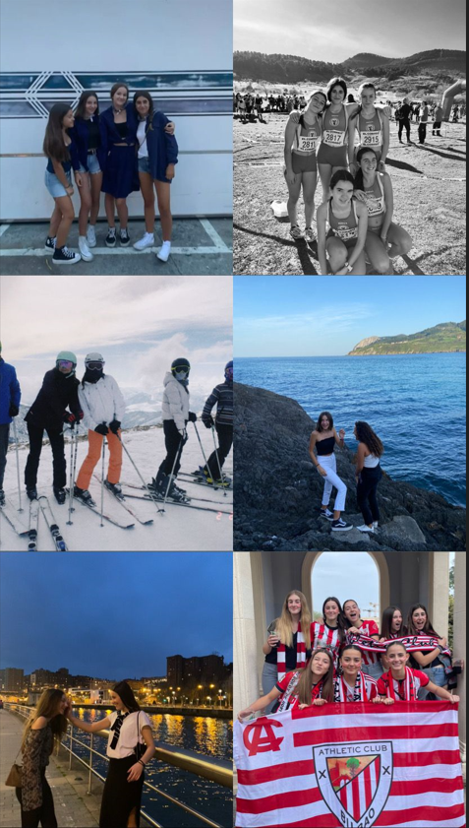
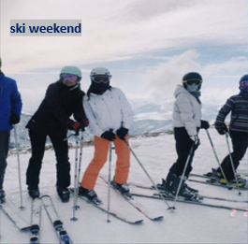
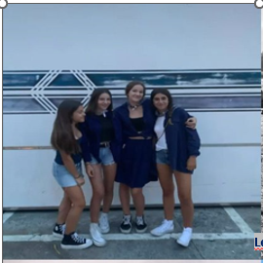
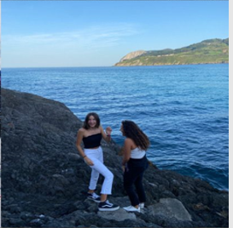
I am in an athletics club and I practice running, jumping.... and we also compete almost every weekend
celebrating that athletic futbol club of bilbao won the king's cup
Maria
Geese party in LEKEITIO: the place where we spend the month of august
Ski weekend with friends organized by high school
I love going out with my friends
Lekeitio
Maria with her Friends in Bibao
Athletic club soccer cup champions

